Slide 1
Program 1 Solution

Slide 2
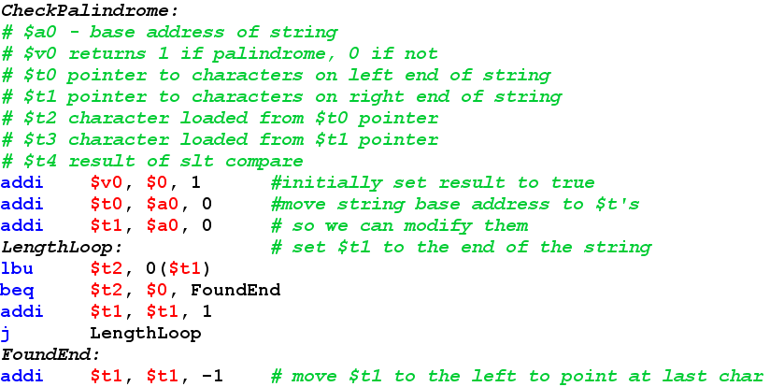
This code finds the right end of the string

Slide 3
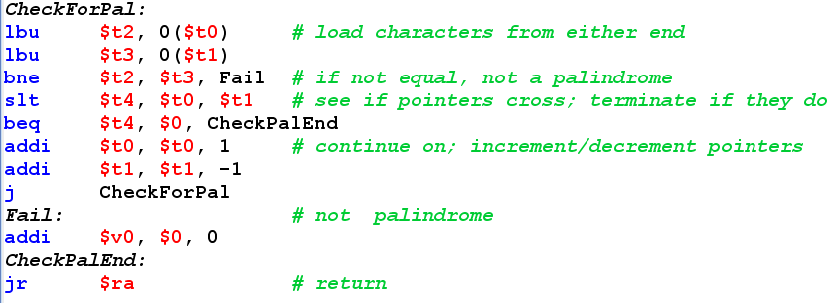
This checks for string symmetry

